Slide 1
Senior Portraits
CADY is our school affiliated photographer.
CADY will provide sittings in the summer for seniors to get a senior portrait.
July 29th, 30th
August 19th
September 24th (only available once the July and August dates fill up)
You will receive an email directly from CADY to schedule
You have the option to then buy packages of photos for personal distribution… etc.
Outside senior portraits through other photography vendors are not coordinated by the school and you will be responsible for submitting the photo to be included in the yearbook.

Slide 2
CADY
PUT CADY VIDEO HERE

Slide 3
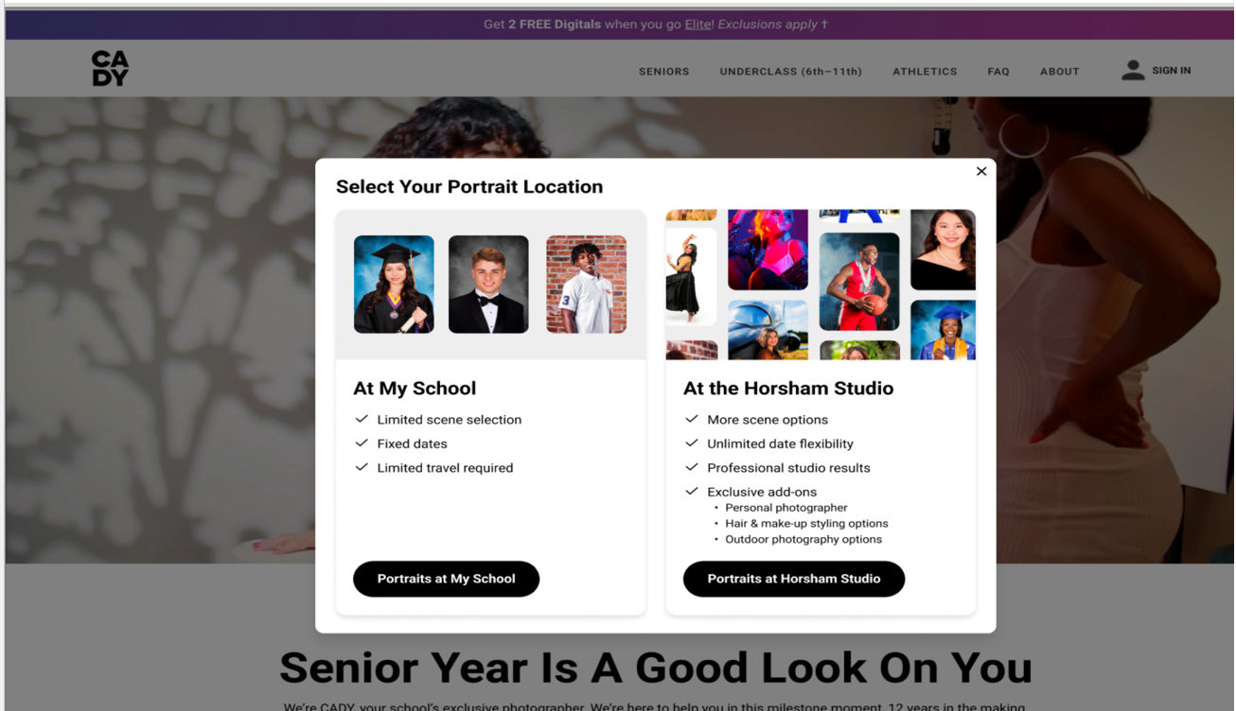
CADY

Slide 4
CADY
Sessions Range based off location that we are photographing at:
There are only 3 Sessions we offer at the School
$0 Session – Formal image and Cap and Gown
Simple Session- Formal, Cap and Gown, 1 Casual Scene
Standard Session- Formal, Cap and Gown, 2 Casual Scenes
Studio Sessions:
All of the above sessions are available at the studio plus many many more.
For more info on Session types or booking visit the CADY website: https://home.cady.com/
Or call our Customer Care team at: 678-534-5384

Slide 5
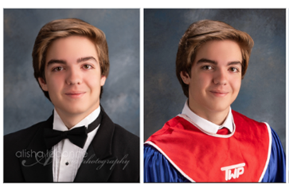
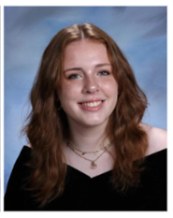
Outside Senior Portrait Requirements
A vertical headshot.
High resolution, typically 300 dpi and a JPEG file.
Formal Attire of Graduation Gown
A white shirt with dark tie and dark jacket
A black drape
Township graduation gown with the township bib. (No graduation caps may appear in the photo).
Background must be light blue or light gray.

Slide 6
Submitting the Senior Portrait
If you have your portrait taken with CADY, once you select your image for the yearbook, no further action is required.
If you use an outside photographer
Expect an email mid-October with specific directions on how to submit
Many outside photographers will submit the portrait for you
Follow – up with your photographer.
DEADLINE for Senior Portraits Class of 2026
Friday - November 7, 2025
cdowdell@wtps.org

